Slide 1
Systems modeling and statistical analysis allows comparison in the response to cold shock in Saccharomyces cerevisiae between Hap4 and randomly generated networks
Kristen M. Horstmann
Departments of Biology and Mathematics
Loyola Marymount University
Undergraduate Research Symposium
March 25, 2017

Slide 2
Outline
Yeast respond to cold shock by changing gene expression.
Microarray data was generated for yeast under cold shock conditions and was used to create networks generated from the YEASTRACT database
Random networks were generated using an R-script and predetermined genes.
The dynamics of each gene in the network was modeled using ordinary differential equations.
Gephi was used to analyze connectivity and statistics of nodes in ΔHAP4 data-derived network.
Betweenness centrality is believed to be better indicator of connectivity than eccentricity, while random networks are likely not biologically comparable.

Slide 3
Outline
Yeast respond to cold shock by changing gene expression.
Microarray data was generated for yeast under cold shock conditions and was used to create networks generated from the YEASTRACT database
Random networks were generated using an R-script and predetermined genes.
The dynamics of each gene in the network was modeled using ordinary differential equations.
Gephi was used to analyze connectivity and statistics of nodes in ΔHAP4 data-derived network.
Betweenness centrality is believed to be better indicator of connectivity than eccentricity, while random networks are likely not biologically comparable.

Slide 4
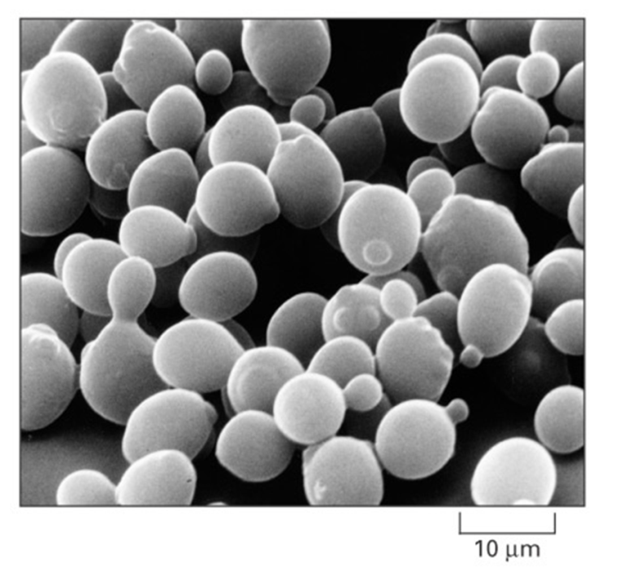
Saccharomyces cerevisiae is an ideal model organism for systems biology
Budding yeast is considered model organism due to its small genome size of approximately 6000 genes.
These genes are regulated by ~250 transcription factors, which can increase or decrease gene expression.
Yeast deletion strains and other molecular genetic tools are readily available.
Cold shock (10-18 ℃) response is not as well documented or previously studied as heat shock
Alberts et al. (2004)

Slide 5
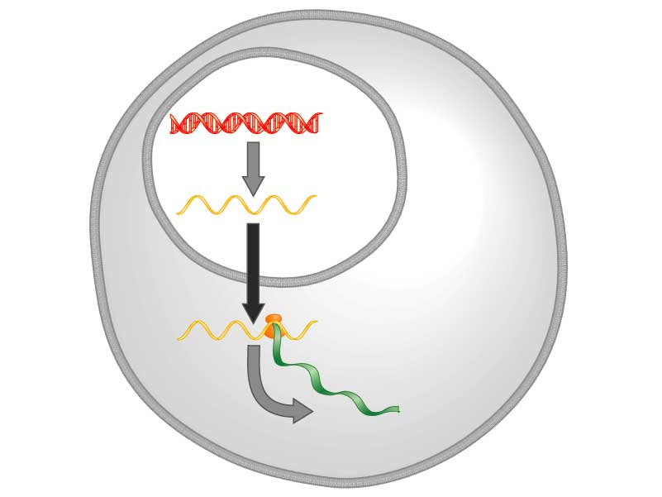
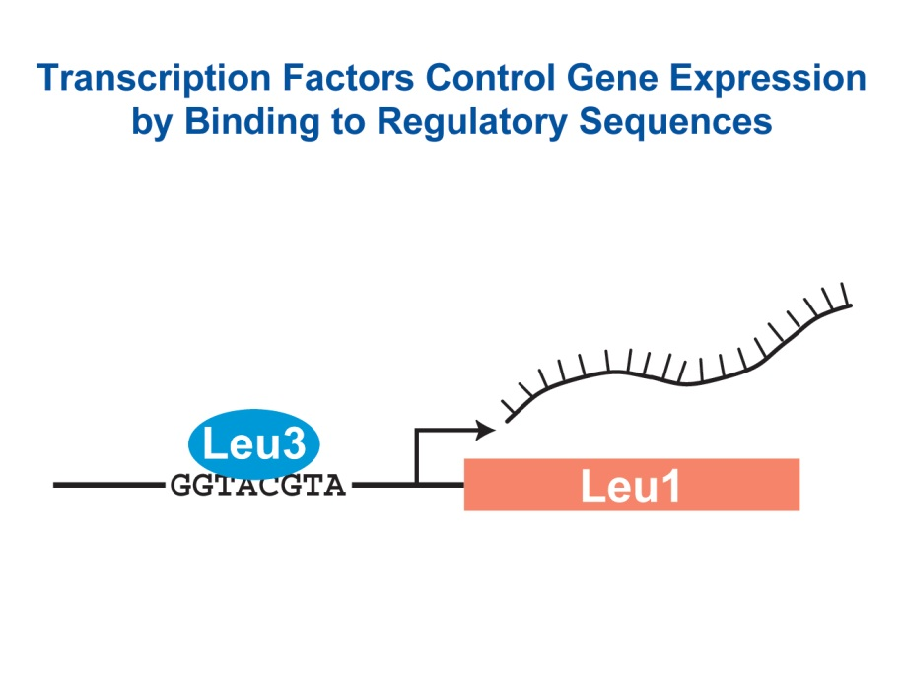
Yeast respond to cold shock by changing the level of gene expression
Transcription factors control gene expression by binding to regulatory DNA sequences.
Activators increase expression while repressors decrease expression
Transcription factors are themselves proteins encoded by genes.
A gene regulatory network (GRN) is a set of transcription factors that regulate the expression of genes encoding other transcription factors.
DNA
Transcription
mRNA
Translation
Protein
Freeman (2003)

Slide 6
Outline
Yeast respond to cold shock by changing gene expression.
Microarray data was generated for yeast under cold shock conditions and was used to create networks generated from the YEASTRACT database
Random networks were generated using an R-script and predetermined genes.
The dynamics of each gene in the network was modeled using ordinary differential equations.
Gephi was used to analyze connectivity and statistics of nodes in ΔHAP4 data-derived network.
Betweenness centrality is believed to be better indicator of connectivity than eccentricity, while random networks are likely not biologically comparable.

Slide 7
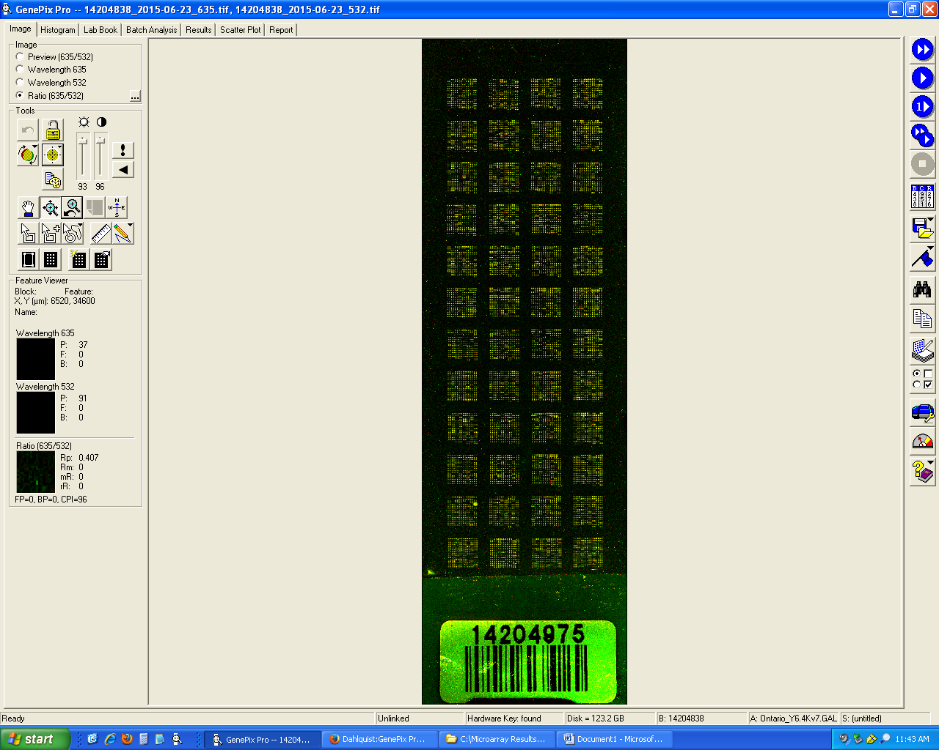
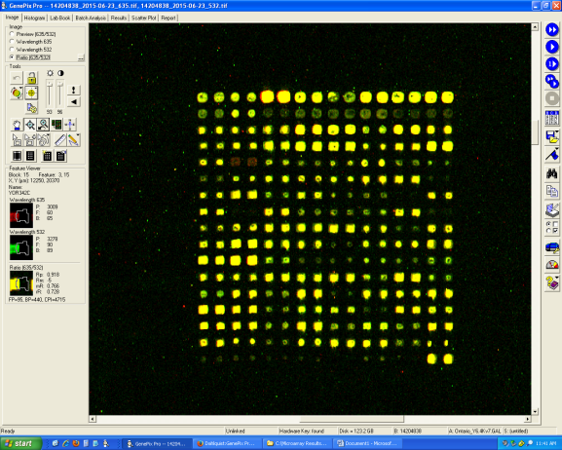
Microarray data is used to observe changes in gene expression for all 6000 genes in yeast
Each spot contains DNA from one gene.
For each spot:
Increase Expression
Decrease Expression
No Change in Expression
DNA microarray experiments were performed for the wild type and five transcription factor deletion strains (Δcin5, Δgln3, Δhap4, Δhmo1, and Δzap1).
For this analysis, only the Δhap4 data-derived network was used
Sample Microarray Slide from the Dahlquist Lab

Slide 8
The Δhap4 strain microarray data was used to derive a family of related GRNs from the YEASTRACT database
Indicates which genes had significant changes in expression at any time point
YEASTRACT Database
These genes were submitted to the YEASTRACT database, which returned a list of candidate regulatory transcription factors that potentially regulate those target genes, in order of significance.
Within-strain ANOVA
Generate “Family” of Related Networks
Notes:
Change title

Slide 9
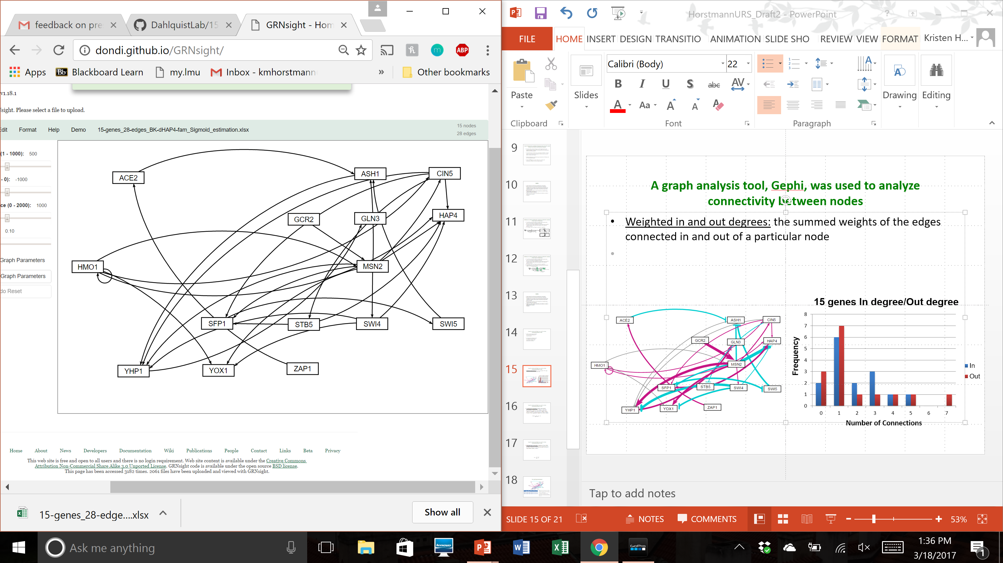
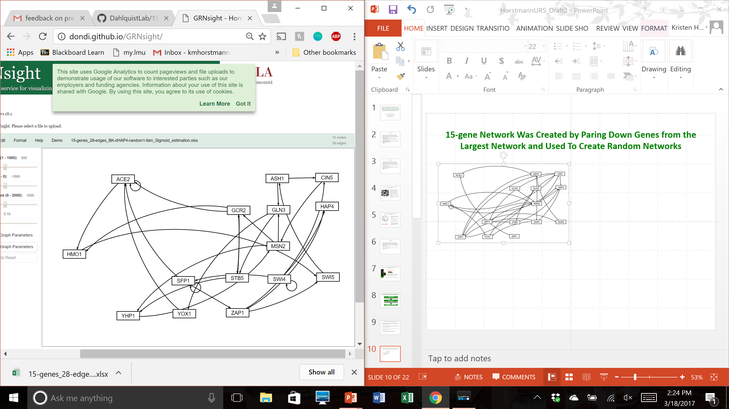
15-gene network was created by paring down genes from the largest network
Δhap4 data-derived network (db5)
Randomized network 1
Pared down larger networks to the most significant 15 genes and 28 edges from YEASTRACT database.

Slide 10
Outline
Yeast respond to cold shock by changing gene expression.
Microarray data was generated for yeast under cold shock conditions and was used to create networks generated from the YEASTRACT database.
Random networks were generated using an R-script and predetermined genes.
The dynamics of each gene in the network was modeled using ordinary differential equations.
Gephi was used to analyze connectivity and statistics of nodes in ΔHAP4 data-derived network.
Betweenness centrality is believed to be better indicator of connectivity than eccentricity, while random networks are likely not biologically comparable.

Slide 11
Random networks were generated using an R-script and predetermined genes
Random networks were created by using a code written on R software.
All 30 random networks use the same genes and same number edges, but the connections and weights of the inputs/outputs are random
Putting Weighted Randoms Here?

Slide 12
Outline
Yeast respond to cold shock by changing gene expression.
Microarray data was generated for yeast under cold shock conditions and was used to create networks generated from the YEASTRACT database
Random networks were generated using an R-script and predetermined genes.
The dynamics of each gene in the network was modeled using ordinary differential equations.
Gephi was used to analyze connectivity and statistics of nodes in ΔHAP4 data-derived network.
Betweenness centrality is believed to be better indicator of connectivity than eccentricity, while random networks are likely not biologically comparable.

Slide 13
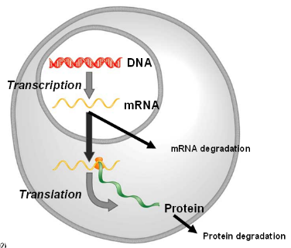
GRNmap uses ordinary differential equations to model the dynamics of each gene
The MATLAB code and executable are available under an open source license at: https://github.com/kdahlquist/GRNmap/.
The expression levels of the transcription factors were modeled using mass balance ordinary differential equations with a sigmoidal production function.
The change in expression of a gene is production - degradation.

Slide 14
GRNmap uses ordinary differential equations to model the dynamics of each gene
The MATLAB code and executable are available under an open source license at: https://github.com/kdahlquist/GRNmap/.
The expression levels of the individual transcription factors were modeled using mass balance ordinary differential equations with a sigmoidal production function.
The change in expression of a gene is production - degradation.
Weight parameter, w, gives the direction (activation/repression) and the magnitude of regulatory relationship
mRNA production rate
mRNA degradation rate
expression of gene
weight term
threshold unique
to each gene

Slide 15
Outline
Yeast respond to cold shock by changing gene expression.
Microarray data was generated for yeast under cold shock conditions and was used to create networks generated from the YEASTRACT database
Random networks were generated using an R-script and predetermined genes.
The dynamics of each gene in the network was modeled using ordinary differential equations.
Gephi was used to analyze connectivity and statistics of nodes in ΔHAP4 data-derived network.
Betweenness centrality is believed to be better indicator of connectivity than eccentricity, while random networks are likely not biologically comparable.

Slide 16
A graph analysis tool, Gephi, was used to analyze connectivity between nodes
Gephi is an open-source software for network visualization and network analysis.
For this project, Gephi was used for finding in and out degrees, eccentricity centrality , and betweenness centrality.

Slide 17
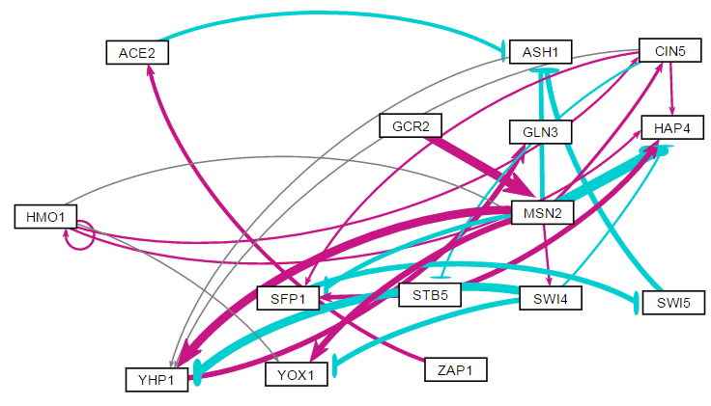
A graph analysis tool, Gephi, was used to analyze connectivity between nodes
Weighted in and out degrees: the summed weights of the edges connected in or out of a particular node
Weighted degrees: the summation of the node’s individual in and out degrees

Slide 18
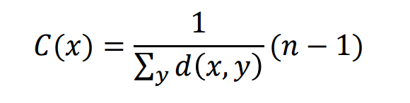
A graph analysis tool, Gephi, was used to analyze connectivity between nodes
Eccentricity centrality: shows how easily accessible a node is from others by finding the “longest” shortest path
Only takes out degree into account. Higher value means other nodes are in proximity and it has a greater impact.
High eccentricity also means that node will be more highly influenced, as all other nodes are close
Highest eccentricity found in db5 was by STB5 and SFP1

Slide 19
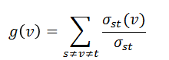
A graph analysis tool, Gephi, was used to analyze connectivity between nodes
Betweenness centrality: measures how often a node, v, is found on the shortest path, σ_{st}, between two other nodes, s and t.
The value given is the number of all the shortest paths that passes through this specific vertex
In weighted networks, the strength is determined by the sum of the weights of its adjacent edges
Three greatest betweenness values were by MSN2 (14), YHP1 (11), and ASH1 (10).
Located along many gene’s shortest paths

Slide 20
Outline
Yeast respond to cold shock by changing gene expression.
Microarray data was generated for yeast under cold shock conditions and was used to create networks generated from the YEASTRACT database
Random networks were generated using an R-script and predetermined genes.
The dynamics of each gene in the network was modeled using ordinary differential equations.
Gephi was used to analyze connectivity and statistics of nodes in ΔHAP4 data-derived network.
Betweenness centrality is believed to be better indicator of connectivity than eccentricity, while random networks are likely not biologically comparable.

Slide 21
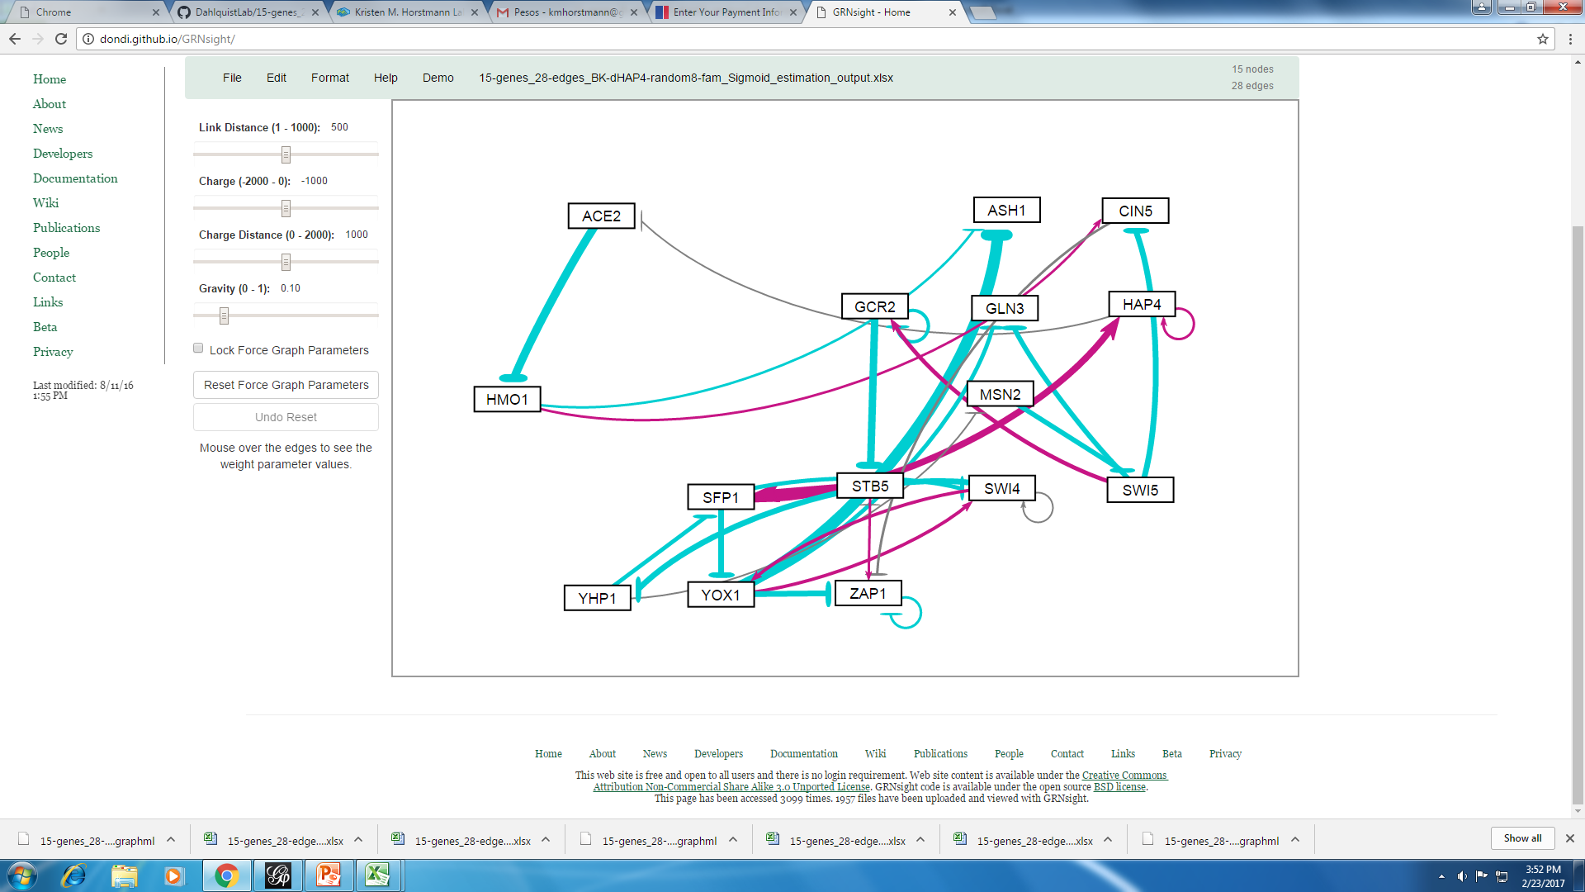
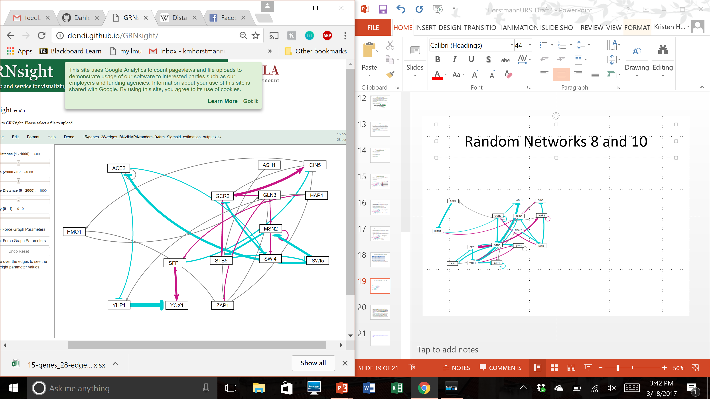
10 randomized networks were compared and interesting betweenness centrality values arose
Random network 8
Random network 10
ID | In Degree | Out Degree | Degree | Eccentricity | Between
SFP1 (8) | 2.262 | -0.731 | 1.531 | 5 | 99
STB5 (8) | -3.204 | 4.053 | 0.849 | 6 | 84
CIN5 (10) | 1.958 | 0.258 | 2.215 | 9 | 78
GLN3 (10) | 0.073 | 1.513 | 1.586 | 7 | 74
MSN2 (10) | -1.952 | -0.832 | -2.784 | 6 | 73.33

Slide 22
10 randomized networks were compared and interesting betweenness centrality values arose
There appears to be no correlation between the degrees of connectivity and the betweenness centrality value.
The HAP4 network betweenness centrality values were much lower than the randomized.
Natural networks are less likely to put individual genes in such important roles in case of malfunction or mutation
Likely there are biological factors in the natural networks that have not or cannot be coded for the random networks.
ID | In Degree | Out Degree | Degree | Between
MSN2 (db5) | 3.325 | -0.866 | 2.459 | 14
YHP1 (db5) | 0.0319 | 1.799 | 1.830 | 11
ASH1 (db5) | -4.231 | 0.103 | -4.128 | 10
SFP1 (8) | 2.262 | -0.731 | 1.531 | 99
STB5 (8) | -3.204 | 4.053 | 0.849 | 84
CIN5 (10) | 1.958 | 0.258 | 2.215 | 78
GLN3 (10) | 0.073 | 1.513 | 1.586 | 74
MSN2 (10) | -1.952 | -0.832 | -2.784 | 73.33

Slide 23
Betweenness centrality may be better indicator of a node’s importance than eccentricity value
ID | Weighted Degree | Eccentricity | Between
ACE2 | -0.005 | 3 | 3
ASH1 | -4.128 | 2 | 10
CIN5 | 1.750 | 3 | 5
GCR2 | 3.224 | 3 | 0
GLN3 | 1.799 | 0 | 0
HAP4 | -1.669 | 0 | 0
HMO1 | 2.087 | 3 | 0
MSN2 | 2.459 | 2 | 14
SFP1 | -1.219 | 4 | 9
STB5 | 3.005 | 5 | 0
SWI4 | -4.455 | 2 | 0
SWI5 | -3.570 | 3 | 7
YHP1 | 1.830 | 1 | 11
YOX1 | 0.448 | 0 | 0
ZAP1 | 0.917 | 4 | 0
Betweenness centrality measures how often a node is within anothers shortest path, while eccentricity measures how close it is to others
STB5 and SWI4: close to others but not used often in paths
MSN2: Major “station” in shortest paths although low eccentricity

Slide 24
First steps in network analysis may be useful for determining measurements to be used
Gephi was found to be a user-friendly and useful tool when analyzing the networks and node connectivity.
Many more centrality equations to be compared, but betweenness centrality was most indicative of a node’s importance in a network.
MSN2, YHP1, and ASH1 were found to be most highly connected and used “stepping stones” in db5 network.
Random networks were useful for exploring the kinds of connections available, but underlying biological factors are not within the model, causing discrepancies when analyzing them.

Slide 25
Acknowledgements
GRNmap data analysis team: Margaret J. O’Neil, Natalie Williams, Brandon Klein
GRNmap coding team: Trixie A. Roque, Nicholas A. Rohacz, Katrina Sherbina, Eileen Choe, and Chukwuemeka Azinge
GRNsight team: Nicole A. Anguiano, Anindita Varshneya, and Mihir Samdarshi
Wet-lab team: Cybele Arsan, Wesley Citti, Kevin Entzminger, Andrew Herman, Monica Hong, Heather King, Lauren Kubeck, Stephanie Kuelbs, Elizabeth Liu, Matthew Mejia, Kevin McGee, Kenny Rodriguez, Olivia Sakhon, Alondra Vega, and Kevin Wyllie.
Mentors: Dr. Kam Dahlquist and Dr. Ben Fitzpatrick

Slide 26
References
“Betweenness Centrality." University of Chieti-Pescara, Science Department, n.d. Web. 16 Mar. 2017. https://www.sci.unich.it/~francesc/teaching/network/betweeness.html
Dahlquist, K., Fitzpatrick, B., Camacho, E., Entzminger, S., & Wanner, N. (2015). Parameter Estimation for Gene Regulatory Networks from Microarray Data: Cold Shock Response in Saccharomyces cerevisiae. Bulletin Of Mathematical Biology, 77(8), 1457-1492. http://dx.doi.org/10.1007/s11538-015-0092-6.
Dário Abdulrehman, Pedro T. Monteiro, Miguel C. Teixeira, Nuno P. Mira, Artur B. Lourenço, Sandra C. dos Santos, Tânia R. Cabrito, Alexandre P. Francisco, Sara C. Madeira, Ricardo S. Aires, Arlindo L. Oliveira, Isabel Sá-Correia, Ana T. Freitas (2011). YEASTRACT: providing a programmatic access to curated transcriptional regulatory associations in Saccharomyces cerevisiae through a web services interface Nucl. Acids Res., 39: D136-D140, Oxford University Press.
"Eccentricity." Center for Biomedical Computing, University of Verona, n.d. Web. 18 Mar. 2017. http://www.cbmc.it/fastcent/doc/Eccentricity.htm
Freeman, S. (2002). Biological science. Upper Saddle River, NJ: Prentice Hall.
GRNsight. (n.d.). Retrieved February 28, 2017, from http://dondi.github.io/GRNsight/
Gephi. (n.d.). Retrieved November 28, 2016, from https://gephi.org/

Slide 27
Thank you for listening!
Questions?

